Slide 1
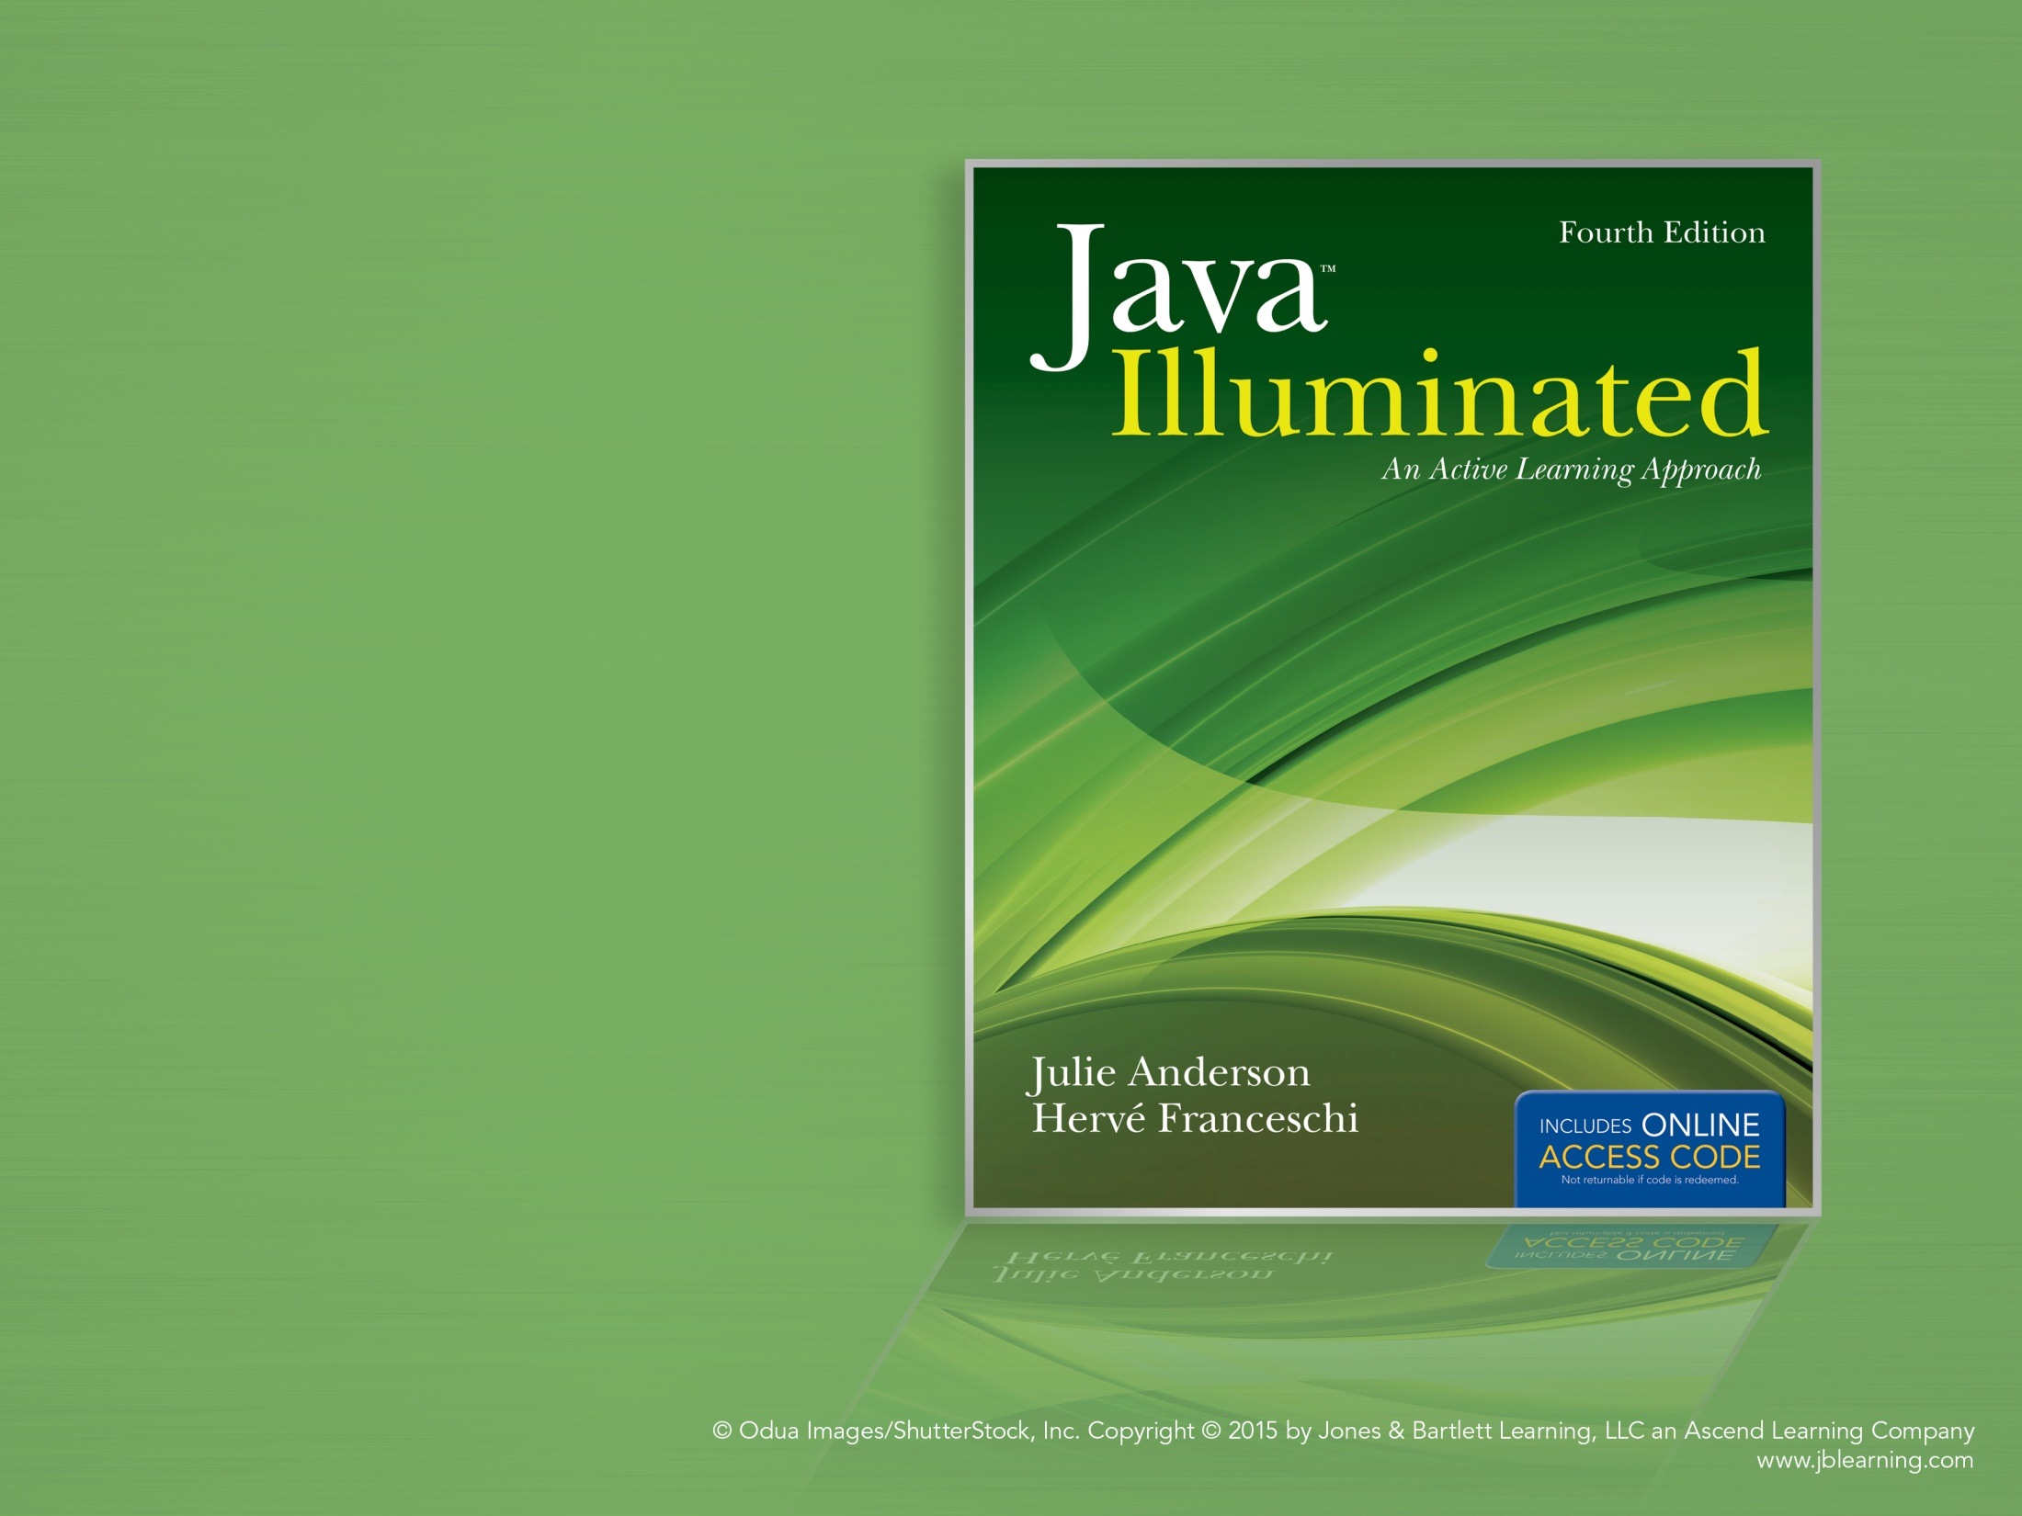
Chapter 6
Flow of Control Part 2:
Looping

Slide 2
Topics
Event-Controlled Loops Using while
Looping Techniques
Type-Safe Input Using Scanner
Constructing Loop Conditions
Testing Techniques for while Loops
Event-Controlled Loops Using do/while
Count-Controlled Loops Using for
Nested Loops

Slide 3
The Grocery Cashier
A grocery cashier's job is to calculate the total costs of the items in the cart.
  The cashier starts with a total of $0.00.
  The cashier scans an item to get its price and adds the price to the total.
  The cashier scans the next item to get its price and adds the price to the total.
  …
  When there are no more items to scan, the total is complete.
Notice that the cashier is performing the same operations on each item!

Slide 4
Looping
In computing, we often need to perform the same operations on multiple items.
Typically, these tasks follow this pattern:
  initialize values (set total to 0)
  process items one at a time (add price to total)
  report results (report total)
The flow of control that programmers use to complete jobs with this repetitive pattern is called looping or iteration.

Slide 5
The while Loop
The while loop is designed for repeating a set of operations on data items when we don't know how many data items there will be.
When we reach the end of the items to process, we will get some signal (For the grocery cashier, it's the divider bar.)
  The end of data items could be indicated by a special input value called a sentinel value or by reaching the end of a file.
Receiving the signal is an event; we call this event-controlled looping.

Slide 6
while Loop Syntax
// initialize variables
while ( boolean expression )
{
// process data (loop body)
}
// process the results
**Notes:
Curly braces are optional if the loop body consists of only one statement
Any variable defined within the while loop has block scope and cannot be referenced after the while loop.

Slide 7
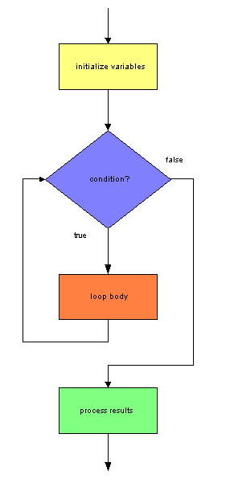
while Loop Flow of Control
The condition is evaluated.
If it is true, we execute the loop.
Then the condition is re-evaluated.
As long as the condition is true,
we execute the loop body.
When the condition is false,
we skip to the instruction
following the loop.

Slide 8
Operation of the while Loop
If the condition evaluates to true, the loop body is executed, then the condition is re-evaluated.
As long as the condition evaluates to true, we continue to repeat the loop body.
The loop body usually "updates the loop condition;" that is, performs some operation that eventually will cause the loop condition to evaluate to false.
Typically, the loop update will be an attempt to read the next input value in order to detect the sentinel value or the end of the file.

Slide 9

SOFTWARE
ENGINEERING TIP
Indent the body of a while loop to clearly illustrate the logic of the program.

Slide 10
Some Definitions
iteration
  one execution of the loop body
loop update
  one or more statements that could cause the loop condition to evaluate to false (and thus end the looping)
loop termination condition
  the event that causes the loop condition to evaluate to false

Slide 11
The Endless Loop
If the loop condition never evaluates to false, the loop body is executed continuously, without end.
We call this an endless loop or an infinite loop.
How can we tell we have an infinite loop?
  If the loop body has no output, the computer appears to hang.
  If the loop body produces output, the output is repeatedly written without end.
How can we stop an infinite loop?
  Abort the program.

Slide 12

Common Error Trap
Avoid putting a semicolon after the condition of a while loop. Doing so creates an empty loop body and could result in an endless loop.
This code causes an endless loop:
int i = 0;
while ( i < 10 ); // empty loop body
{
i++; // this statement follows the loop
}
The semicolon indicates an empty loop body; i++ is never executed because it is not part of the loop body, so the condition is always true.

Slide 13
Pseudocode for the Grocery Cashier
set total to $0.00
reach for first item
while item is not the divider bar
{
get price of item
add price to total
reach for next item // loop update
}
// if we get here, the item is the
// divider bar
output the total price

Slide 14
Sentinel-Controlled while Loop
initialize variables
// priming read
read the first data item
while ( item is not the sentinel value )
{
process the item
// update read
read the next data item
}
report the results

Slide 15
Common Error Trap
Omitting the update read may result in an endless loop.
Example:
System.out.print( "Enter a value > " );
int input = scan.nextInt( );
while ( input != 10 ) // 10 is sentinel value
System.out.println( input );
If the value entered for input is not 10, this is an endless loop because we never read a new value for input. Thus, the condition always evaluates to true.

Slide 16
Common Error Trap
Omitting the priming read causes the sentinel value to be processed, leading to incorrect results.
Example:
int count = 0, input = -1;
while ( input != 0 ) // 0 is sentinel value
{
System.out.print( "Enter an integer > " );
input = scan.nextInt( );
count++;
}
System.out.println( "Count is " + count );
If the user enters the values 20, 30, 0, the output will be "Count is 3", which is incorrect.

Slide 17
Example 6.1
See EchoUserInput.java
We read integers from the user until the user enters -1. Thus, -1 is the sentinel value.
To process the data, we echo the user input to console.
This is a sentinel-controlled loop. We do not know in advance how many integers the user will enter.

Slide 18
Reading from a Text File
If the input is stored in a file, the pattern for our loop is different.
Reaching the end of the file is our signal that there is no more data.
initialize variables
while ( there is more data in the file )
{
read the next data item
process the data
}
report the results

Slide 19
Setup for Reading from a File
Example:
File inputFile = new File( "input.txt" );
Scanner file = new Scanner( inputFile );
A File Class ( java.io package ) Constructor
File( String pathname ) constructs a File object with the file name pathname
A Scanner Constructor for Reading a File
Scanner( File file ) creates a Scanner object associated with a file

Slide 20
Scanner Class hasNext Method
This method detects the end of the input values.
The hasNext method eliminates the need for a priming read because the method looks ahead for input.
An IOException may be generated if we encounter problems reading the file. Java requires us to acknowledge that these exceptions may be generated. One way to do this is to add this clause to the main definition
throws IOException
See Example 6.2 EchoFileData.java
Return type | Method name and argument list
boolean | hasNext( ) returns true if there is more data in the file; returns false when the end of the file is reached.

Slide 21
Looping Techniques
There are standard patterns and techniques for performing common programming operations:
  Accumulation
  Counting Items
  Finding an Average
  Finding Maximum or Minimum Values
  Animation

Slide 22
Accumulation
Calculating a total of input values
Approach: the running total
  We start by initializing a total variable to 0.
  Each time we read a value, we add the value to the total.
  When we have no more values to read, the total is complete.
Note that this is the same pattern used by the grocery cashier.

Slide 23
Accumulation Pseudocode
set total to 0 // very important!
read a number // priming read
while ( number is not the sentinel value )
{
add the number to total
read the next number // update read
}
output the total
See Example 6.3 Calculator.java

Slide 24
Common Error Trap
Forgetting to initialize the total variable to 0 before beginning the loop will produce incorrect results.

Slide 25
Counting Items
For example, how many people bought a regular ticket? A child’s ticket? A senior ticket?
Approach: the running count
  We start by initializing a count variable to 0.
  Each time we read a value, we check whether that value meets the criteria for something we want to count. If so, we increment the count variable by 1.
  When we are finishing reading values, the count is complete.

Slide 26
Counting Items Pseudocode
set count to 0 // very important!!
read input // priming read
while ( input is not the sentinel value )
{
if ( input is what we want to count ) add 1 to count
read the next input // update read
}
output count
See Example 6.4 CountTestScores.java

Slide 27
Common Error Trap
Forgetting to initialize the count variable to 0 before beginning the loop will produce incorrect results.

Slide 28
Calculating an Average
Approach: combine accumulation and counting
We start by initializing a total variable and a count variable to 0.
Each time we read an item, we add its value to the total variable and increment the count variable.
When we have no more items to read, we calculate the average by dividing the total by the count.

Slide 29
Calculating an Average Pseudocode
set total to 0
set count to 0
read a number
while ( number is not the sentinel value )
{
add the number to total
add 1 to the count
read the next number
}
set average to total / count
output the average
See Example 6.5 AverageTestScore.java

Slide 30
Common Error Trap
Forgetting to check whether the denominator is 0 before performing division is a logic error.
  In integer division, if the divisor is 0, an ArithmeticException is generated.
  In floating-point division, if the divisor is 0,
    and the dividend is also 0,
    the result is NaN
    and the dividend is not 0,
    the result is Infinity

Slide 31
Correct Calculation
Remember that if we declare total and count as integers, then average will be calculated using integer division, which truncates the remainder.
average = total / count; // integer result
To get a floating-point average, we need to type cast one of the variables (either total or count) to a double or a float to force the division to be performed as floating point.
Correct code:
double average = (double) ( total ) / count;

Slide 32
Finding Maximum/Minimum Values
Approach: the running maximum or minimum
For the maximum (minimum is similar):
  Read the first item and save its value as the current maximum
  Each time we read a new value, we compare it to the current maximum.
    If the new value is greater than the current maximum, we replace the current maximum with the new value.
  When we have no more items to read, the current maximum is the maximum for all values.

Slide 33
Finding Maximum Value Pseudocode (Reading From a File)
read a number
make that number the maximum
while ( there is another number to read )
{
read the next number
if ( number > maximum )
{
set maximum to number
}
}
output the maximum
See Example 6.6 FindMaximumGrade.java

Slide 34
SOFTWARE
ENGINEERING TIP
Initializing a maximum or a minimum to an arbitrary value, such as 0 or 100, is a logic error and could result in incorrect results.
For example, if we initialize the maximum to 0 and all the input values are less than 0, then we will incorrectly report 0 as the maximum.
Similarly, if we initialize the minimum to 0 and all the input values are greater than 0, then we will incorrectly report 0 as the minimum.

Slide 35
Animation
Moving an object (for example, a ball) across the window by changing its starting coordinate and redrawing the object.
Drawing a figure using offsets from a starting (x, y) coordinate makes this easy.
To roll a ball from left to right, the loop should terminate when we reach the right edge of the window.
Thus, our loop condition becomes:
startX + width < windowWidth - border

Slide 36
The Circle Class
We will use the authors’ Circle class to draw a ball.
For example, this statement:
Circle ball = new Circle( 100, 200, 50,
Color.RED );
instantiates a Circle object named ball with the upper left (x,y) coordinate of (100, 200), a diameter of 50, and the color red.
The Circle Class Constructor
Circle( int sX, int sY, int sDiam, Color sColor ) constructs a Circle object; sets x and y to sX and sY, respectively; diameter to sDiam; and color to sColor.

Slide 37
Circle Class Methods
Return type | Method name and argument list
int | getX( ) returns the Circle's x value
void | setX( int newX ) sets the Circle's x value to newX
int | getY( ) returns the Circle's y value
void | setY( int newY ) sets the Circle's y value to newY
int | getDiameter( ) returns the Circle's diameter
void | setDiameter( int newDiameter ) sets the Circle's diameter to newDiameter

Slide 38
Circle Class Methods (con't)
Return type | Method name and argument list
Color | getColor( ) returns the Circle's color
void | setColor( Color newColor ) sets the Circle's color to newColor
void | draw( Graphics g ) draws a filled circle with x and y being the upper-left corner of its bounding rectangle, and with the diameter and color set in the object.

Slide 39
Animation First Attempt
To get the width of the window, we call the getWidth method in the JFrame class with this API:
In a while loop, we increment x by the ball diameter, plus a constant space between balls (MOVE)
ball.setX( ball.getX( )
+ ballDiameter + MOVE );
See Example 6.7 RollABall1.java
Return type | Method name and argument list
int | getWidth( ) returns the current width of the window in pixels

Slide 40
Result
All the balls appear at once.
There is no sensation of movement.
Solution:
  Slow down the time between each drawing of the ball.
  Erase the current ball before drawing the next one.

Slide 41
Slow Down the Execution
We can slow down the animation by calling the static wait method in the authors’ Pause class from the while loop body
Example:
Pause.wait( .03 ); // pause 3/100th of a second
Return type | Method name and argument list
void | wait( double seconds ) static method that pauses execution for the number of seconds specified.

Slide 42
Erase the Ball
To erase the previous ball before drawing the new ball, call the clearRect method in Graphics class:
Get the window height by calling the getHeight method in the JFrame class
Return type | Method name and argument list
void | clearRect( int x, int y, int width, int height ) draws a filled rectangle in the background color
Return type | Method name and argument list
int | getHeight( ) returns the current height of the window in pixels

Slide 43
Pseudocode for Animation
set starting (x, y) coordinate
instantiate the ball object
while ( x + diameter is within the window )
{
draw the ball
pause
erase the ball
set (x, y) coordinate to next
drawing position
}
draw the ball
See Example 6.8 RollABall2.java
We get the rolling effect we want!

Slide 44
Input Problems
What happens if the user does not enter the data type we request?
  The Scanner next… methods generate an InputMismatchException
  The program terminates; any remaining statements are not executed.
  This is not professional.
With Example 6.9 ReadInteger.java, try entering data other than an int.

Slide 45
Solving the Input Problem
We can check before we read, whether the next input token matches our expected input.
The Scanner class provides hasNext… methods for doing this. The hasNext… methods return true if the next input token can be interpreted as the data type specified.

Slide 46
Scanner Class hasNext… Methods
Each method returns true if the next token in the input stream can be interpreted as the data type requested, and false otherwise.
Return type | Method name and argument list
boolean | hasNextInt( )
boolean | hasNextDouble( )
boolean | hasNextFloat( )
boolean | hasNextByte( )
boolean | hasNextShort( )
boolean | hasNextLong( )
boolean | hasNextBoolean( )
boolean | hasNext( )

Slide 47
Reprompting for Valid Input
If the hasNext method returns false, we need to notify the user that the value typed is not valid and reprompt for new input.
First we need to flush the invalid input using the nextLine method of the Scanner class. Then we just ignore that input.

Slide 48
Scanner nextLine Method
Pseudocode for type-safe input:
  prompt for input
  while ( input does not match type requested )
  {
  flush input
  reprompt
  }
  read the good input
See Example 6.10 TypeSafeReadInteger.java
Return type | Method name and argument list
String | nextLine( ) returns the remaining input on the line as a String

Slide 49
Constructing Loop Conditions
For a sentinel-controlled loop, we want to stop the loop when the input value is the sentinel. This is the loop termination condition.
So we want to keep executing the loop if the input value is NOT the sentinel. This is the loop continuation condition.
Thus, the loop continuation condition is the inverse of the loop termination condition.

Slide 50
Example: A Menu Program
The user can enter 'S' or 's‘ to end the program.
Thus, there are two sentinel values: ‘S' and 's'
We are inclined to form this **incorrect** condition:
while ( option != 'S' || option != 's' )
So:
If the user enters 'S', then option != 's' is true.
If the user enters 's', then option != ‘S' is true.
If the user enters any other character, the condition is also true.
Thus, the condition above causes an endless loop because at least one of the expressions will always be true.

Slide 51
Constructing a Loop Condition
1. Define the loop termination condition, that is, define the condition that will make the loop stop executing.
2. Create the loop continuation condition – the condition that will keep the loop executing – by applying the Logical NOT operator ( ! ) to the loop termination condition.
3. Simplify the loop continuation condition by applying DeMorgan's Laws, where possible.

Slide 52
DeMorgan's Laws
Set of rules to help develop logical expressions that are equivalent
NOT( A AND B ) is equivalent to
( NOT A ) OR ( NOT B )
NOT( A OR B ) is equivalent to
( NOT A ) AND ( NOT B )

Slide 53
According to DeMorgan's Laws:
!( a && b )
is equivalent to
( !a ) || ( !b )
!( a || b )
is equivalent to
( !a ) && ( !b )

Slide 54
Negating Expressions
expression | ! (expression )
a = = b | a != b
a != b | a = = b
a < b | a >= b
a >= b | a < b
a > b | a <= b
a <= b | a > b

Slide 55
Our Menu Condition Revisited
Define the loop termination condition:
( option == 'S' || option == 's' )
Create the loop continuation condition by applying the ! operator:
! ( option == 'S' || option == 's' )
Simplify by applying DeMorgan's Laws:
( option != 'S' && option != 's' )
This condition is correct!
See Example 6.11 BonniesBurgers.java

Slide 56
SOFTWARE
ENGINEERING TIP
Do not check for the sentinel value inside the while loop. Let the while loop condition detect the sentinel value.
Note in Example 6.11 that no code in the switch statement checks for 's' or 'S'. The while loop condition checks for 's' or 'S', so the option variable can never have the value 's' or 'S' inside the loop body.

Slide 57
A Compound Loop Condition
Suppose we want to animate the ball so that it rolls diagonally.
In this case, we will have two possible events:
  the ball has passed the horizontal window border
  the ball has passed the vertical window border

Slide 58
Develop the Loop Condition
We want to roll the ball diagonally down to the right.
1. Loop termination (ball is out of bounds)
( ball.getX( ) + ballDiameter > getWidth( ) - BORDER_RIGHT || ball.getY( ) + ballDiameter > getWidth( ) - BORDER_BOTTOM )
2. Loop continuation (ball is not out of bounds)
! ( ball.getX( ) + ballDiameter > getWidth( ) - BORDER_RIGHT || ball.getY( ) + ballDiameter > getWidth( ) - BORDER_BOTTOM )
3. Simplify (ball is in bounds)
( ball.getX( ) + ballDiameter <= getWidth( ) - BORDER_RIGHT && ball.getY( ) + ballDiameter <= getWidth( ) - BORDER_BOTTOM )
See Example 6.12 RollABall3.java

Slide 59
Testing Techniques for while Loops
Does the program produce correct results with a set of known input values?
Does the program produce correct results if the sentinel value is the first and only input?
Does the program deal appropriately with invalid input?

Slide 60
Testing Technique 1
Does the program produce correct results with known input?
To verify, select input values, calculate by hand, and compare output to hand-calculated values.
Check boundary values
  such as lowest or highest expected values
Check "edge" values of if statements
    For example, with this if condition:
    ( age >= 18 )
    we should test the program with values 17, 18, and 19

Slide 61
Testing Techniques 2 and 3
2. Does the program produce correct results if the sentinel value is the first and only input?
Result: the while loop is not executed; will reported results be correct?
To test: Enter sentinel value at first prompt
3. Does the program deal appropriately with invalid input?
Possible results: an exception is generated or an incorrect action is performed
To test: Enter invalid data

Slide 62
The do/while Loop
Unlike the while loop, the condition for the do/while loop is evaluated at the end of the loop.
Thus, a do/while loop executes at least once.
Some uses for a do/while loop:
  Validate user input
  Ask if the user wants to repeat an operation, such as play a game again.

Slide 63
do/while Syntax
// initialize variables
do
{
// body of loop
} while ( condition );
// process the results

Slide 64
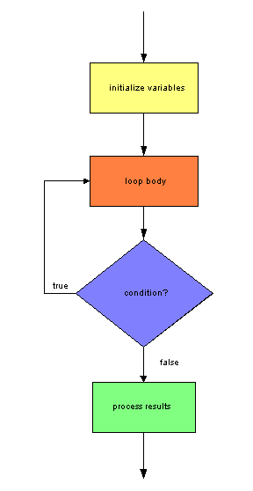
do/while Flow of Control
The do/while loop body is executed,
then the condition is checked. If the
condition is true, the loop body is
repeated. If the condition is false,
the loop body is not repeated.

Slide 65
Example:Validate User Input
We can use a do/while loop to check whether the user input is valid.
We prompt the user inside the do/while loop.
If the user input is not valid, we want to reprompt until the user enters a valid value. Thus, we form the condition so that it is true if the user enters invalid data.
Because of scope rules, any value that will be tested in the do/while loop condition must be defined before the do/while loop.
See Example 6.13 ValidateInput.java

Slide 66
Common Error Trap
Do not use an if statement to validate input because it will catch invalid values entered the first time only.
A do/while loop will continue to prompt the user until the user enters a valid value.

Slide 67
To Repeat an Operation
Example code using a do/while loop to prompt the user to play a game again:
do
{
// code to play a game
System.out.print( "Play again (yes/no)? ")
String answer = scan.next( );
} while ( answer.equalsIgnoreCase( "yes" ) );

Slide 68
The for Loop
Ideal when before the loop begins, you know the number of iterations to perform.
Examples:
  Find the sum of 5 numbers
  Find the maximum of 20 numbers
  Print the odd numbers from 1 to 10

Slide 69
The for Loop Syntax
for ( initialization; loop condition; loop update )
{
// loop body
}
Notes:
semicolons separate terms in the loop header
no semicolon follows the loop header
curly braces are required only if more than one statement is in the loop body

Slide 70
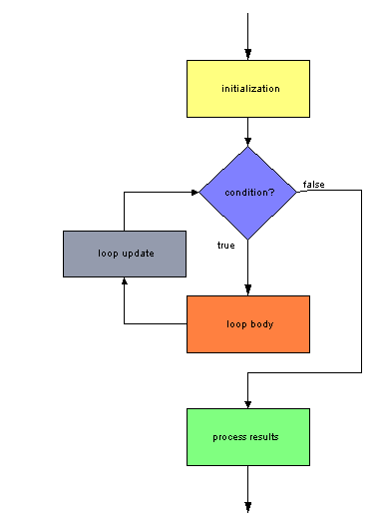
for Loop Flow of Control
The initialization statement is executed (once only).
The loop condition is evaluated.
If the condition is true, the loop body
is executed.
The loop update statement is then executed, and the loop condition is reevaluated.

Slide 71
Using a Loop Control Variable
A loop control variable is convenient for counting iterations of for loops.
  We set its initial value in the initialization statement
  We check its value in the loop condition
  We increment or decrement its value in the loop update statement

Slide 72
Example: Find Sum of 5 Integers
set total to 0
for i = 1 to 5 by 1
{
read integer
add integer to total
}
print the total
See Example 6.15 Sum5Numbers.java

Slide 73
Update Increment Can Be > 1
Print the even numbers from 0 to 20
set output to an empty String
for i = 0 to 20 by 2
{
append i and a space to output
}
print output
See Example 6.16 PrintEven.java

Slide 74
Loop Control Variable Scope
When a loop control variable is declared inside the for loop header, it cannot be referenced after the loop
for ( int i = 0; i < 3; i++ )
{
System.out.println( i ); // ok
}
System.out.println( i ); // error: i is
// undefined here

Slide 75
To Reference i After the Loop
Declare i before the loop:
int i; // declare i before loop
for ( i = 0; i < 3; i++ )
{
System.out.println( i );
}
System.out.println( i ); // ok

Slide 76
Decrementing the Loop Variable
Printing a string backwards:
set backwards to an empty String
read a sentence
for i = length of sentence – 1 to 0 by –1
{
get character at position i
append character to backwards
}
print backwards
See Example 6.17 Backwards.java

Slide 77
Drawing a Bull's Eye Target
Draw 10 concentric circles
  All circles have the same center point
  Each circle has a different diameter
To alternate colors (black & red), we use a toggle variable
  the variable alternates between two values
We must draw the circles from the largest to the smallest to avoid covering the smaller circles.

Slide 78
Pseudocode for Bull's Eye
initialize color to black
for diameter = 200 to 20 by –20
{
instantiate a circle
draw the circle
if color is black
set color to red
else
set color to black
}
See Example 6.18 Bullseye.java

Slide 79
Testing for Loops
An important test for for loops is that the starting and ending values of the loop variable are set correctly.
For example, to iterate 5 times, use this header:
for ( int i = 0; i < 5; i++ )
or this header:
for ( int i = 1; i <= 5; i++ )

Slide 80
Processing a String (named word)
In the forward direction:
  Correct:
for ( int i = 0; i < word.length( ); i++ )
  Incorrect:
for ( int i = 0; i <= word.length( ); i++ )
**There is no character at word.length( )

Slide 81
Processing a String (named word)
In the reverse direction:
  Correct:
for ( int i = word.length( ) - 1; i >= 0; i-- )
  These are incorrect:
for ( int i = word.length( ); i >= 0; i-- )
** There is no character at word.length( )
for ( int i = word.length( ) - 1; i > 0; i-- )
** This does not process the first character (at index 0).

Slide 82
Testing for Loops
Include a test with data that causes the for loop to execute 0 times (no iterations).
For example: Test Example 6.17 Backwards.java with an empty sentence.

Slide 83
Nested Loops
Loops can be nested inside other loops; that is, the body of one loop can contain another loop.
A while loop can be nested inside another while loop or a for loop can be nested inside another for loop.
A for loop can be nested inside a while loop and a while loop can be nested inside a for loop.

Slide 84
Example: Grocery Checkout
look for a customer in line
while ( there is a customer in line )
{
set total to $0.00
reach for first item
while item is not the divider bar
{
add price to total
reach for next item
}
output the total price
look for another customer in line
}

Slide 85
Nested for Loop Execution
The inner loop executes all its iterations for each single iteration of the outer loop
Example: how can we produce this output?
1
1 2
1 2 3
1 2 3 4
1 2 3 4 5

Slide 86
Analysis
The highest number we print on each line is the same as the line number.
for line = 1 to 5 by 1
{
for number = 1 to line by 1
{
print number and a space
}
print a new line
}
See Example 6.19 NestedForLoops.java

Slide 87
Finding Factors
We'll let the user enter positive integers, with 0 being the sentinel value.
For each number, we'll find all its factors; that is, we will find all the integers that are evenly divisible into the number.
We will not process 1 or the number itself.
If a number is evenly divisible by another, the remainder after division will be 0. Thus, the modulus operator (%) will be useful.

Slide 88
Finding Factors (con't)
To find all the factors of a number, we can test all integers from 1 up to the number, counting all those whose remainder after division is 0.
But: The number 1 is a factor for every number.
So we can begin testing at 2.
And because 2 is the smallest possible factor, there's no need to test integers higher than
number / 2. Thus, our range of integers to test will be from 2 to number / 2.

Slide 89
Finding Factors Pseudocode
read first number // priming read
while number is not 0
{
print "The factors for " + number + " are "
for factor = 2 to ( number / 2 ) by 1
{
if number % factor is 0
print factor and a space
}
print a new line
read next number // update read
}

Slide 90
Finding Factors (con't)
If no factors are found, we want to output that the number is prime.
For this, we need a flag variable.
  We set the flag to false before starting the for loop that checks for factors.
  Inside the for loop, we set the flag to true when we find a factor.
  After the for loop terminates, we check the value of the flag. If it is still false, we did not find any factors and the number is prime.
See Example 6.20 Factors.java

